Slide 1
Flying High: A Review Analysis
of British Airways with User Reviews
Web Scraping To Gain Company Insights

Slide 2
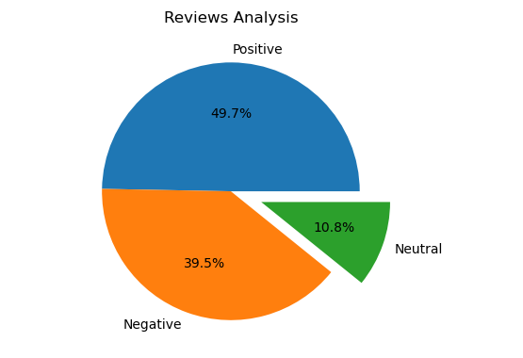
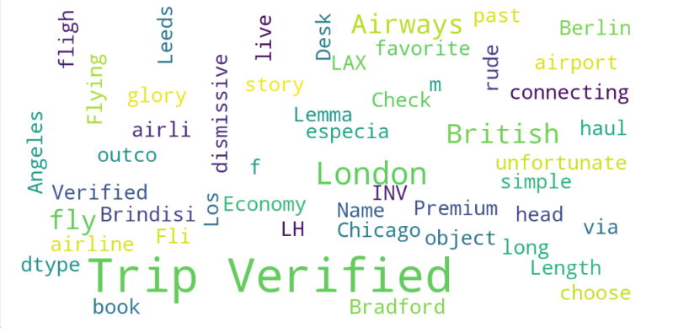
INSIGHTS FROM CUSTOMER REVIEWS
From cleaning 1000 reviews given by the customers, we obtained
Positive Reviews - 497
Negative Reviews - 395
Neutral Reviews – 108
Wordcloud of keywords used in reviews

